Slide 1
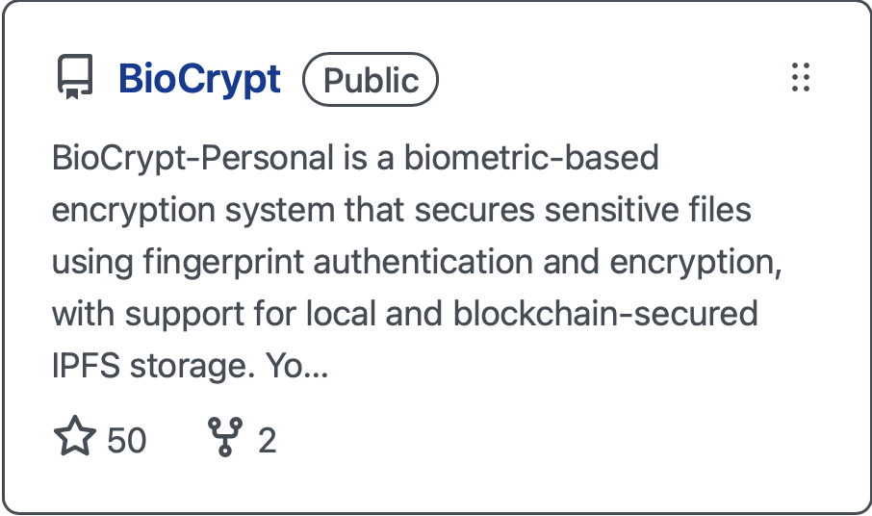
Biometrics File Encryption System with Blockchain storage
BioCrypt
Supervised by:
Dr. Aya Abdelnaby

Slide 2
Table of Contents
Introduction:
Problem Statement
Project Idea
Similar Systems
Project Key Features
System Overview:
System Block Diagram
Final Results:
Marketing & Data Analytics
Prototype (50% of the project)

Slide 3
Introduction

Slide 4
Problem Statement
The Problem:
Sensitive data is vulnerable to breaches due to weak authentication, centralized storage, and lack of encryption during transmission.
Why It Matters:
Cyberattacks are rising in frequency and sophistication
Most systems lack biometric file-level security
Centralized storage is easily compromised
Users need strong security without sacrificing ease of use
Privacy laws demand better data protection

Slide 5
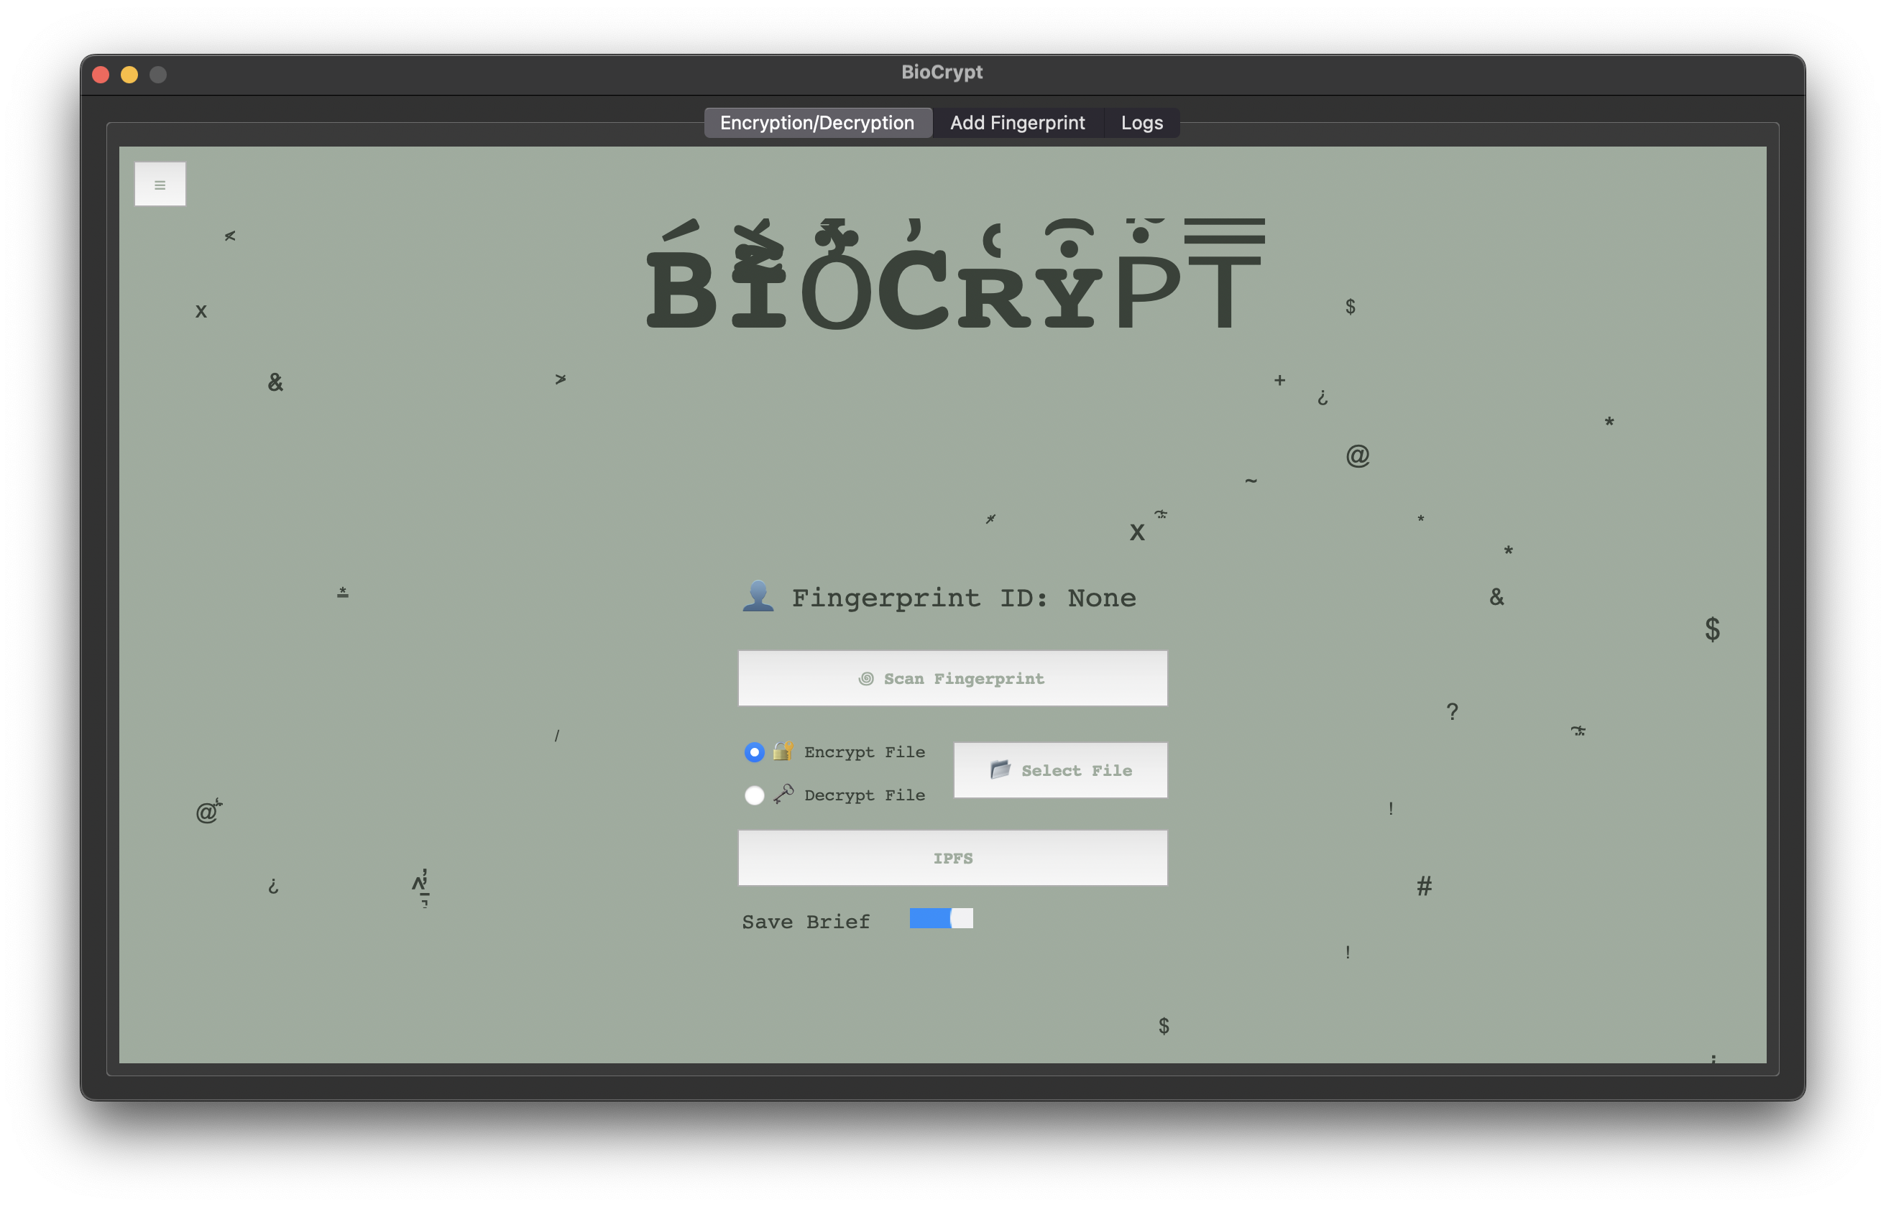
Project Idea
BioCrypt is an advanced biometric-based encryption system designed to secure sensitive files using fingerprint authentication and AES-256 encryption. By integrating biometric authentication, local and cloud storage options, secure email transfers, and blockchain-secured IPFS storage, BioCrypt offers a robust and user-friendly solution for file security in an era of increasing cyber threats.

Slide 6
Similar Systems

Slide 7
What Makes Our System Unique?
Feature/Aspect | BioCrypt | VeraCrypt | BitLocker (Windows) | Signal
Biometric Authentication | ✅ Yes (Fingerprint) | ❌ No | ❌ No | ❌ No
File-Level Encryption | ✅ Yes | ✅ Yes | ❌ No (Full Disk Only) | ✅ Yes (File Sharing Only)
Full Disk Encryption | ❌ No (Focused on files) | ✅ Yes | ✅ Yes | ❌ No
Encryption Algorithm | AES-256 | AES-256, Serpent, Twofish | AES-128 / AES-256 | Signal Protocol (End-to-End Encryption)
Cloud Integration | ✅ Yes (Encrypted cloud storage) | ❌ No | ❌ No | ✅ Yes (File sharing over network)
Secure File Transfer | ✅ Yes (OTP-based secure email transfer) | ❌ No | ❌ No | ✅ Yes
OTP Authentication | ✅ Yes | ❌ No | ❌ No | ✅ Yes (For account verification)
Cross-Platform Support | ✅ Yes (Windows, macOS, Linux) | ✅ Yes (Windows, macOS, Linux) | ❌ No (Windows only) | ✅ Yes (Windows, macOS, Linux, iOS, Android)
Hidden/Stealth Mode | ✅ Yes (Future feature) | ✅ Yes (Hidden Volumes) | ❌ No | ❌ No
User-Friendliness | ✅ High (User-friendly UI with GUI) | ⚠️ Medium (Complex interface) | ✅ High (Seamlessly integrated with Windows) | ✅ High
Backup and Recovery | ✅ Yes (Encrypted backups) | ✅ Yes | ✅ Yes | ❌ No
Man-in-the-Middle Protection | ✅ Yes (Secure transmission protocols) | ❌ No | ✅ Yes (BitLocker with TPM) | ✅ Yes (Signal Protocol)
Cost | Free (Open-source) | Free (Open-source) | Paid (Included with Windows Pro/Enterprise) | Free (Open-source)
Target Users | Individuals & Organizations | Advanced Users & Professionals | Windows Users | General Users (Focused on Communication)
Compliance with Data Regulations | ✅ Yes (Helps with GDPR, HIPAA) | ✅ Yes | ✅ Yes | ✅ Yes

Slide 8
Project Motivation

Slide 9
Scientific Perspective
• Biometric Security: Research shows that biometrics (e.g., fingerprints) offer superior security over passwords (Jain et al., 2004).
• AES-256 Encryption: AES-256 remains one of the most secure encryption standards, resistant to brute-force attacks (Schneier, 1996).
• Cloud Security: Studies highlight the need for end-to-end encryption in cloud storage to prevent breaches (Zhao et al., 2018).
• OTP Authentication: OTPs significantly enhance security for file transfers and access (Wu et al., 2016).
• Usability of Encryption: Research emphasizes the importance of user-friendly encryption systems to improve adoption (Whitten & Tygar, 1999).

Slide 10
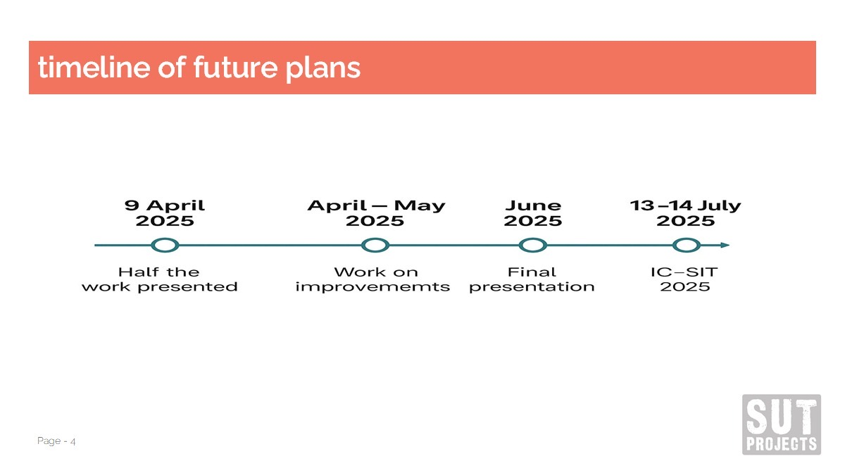
Market Perspective
Market demand or industry trends.
Potential impact or benefits for users and stakeholders.

Slide 11
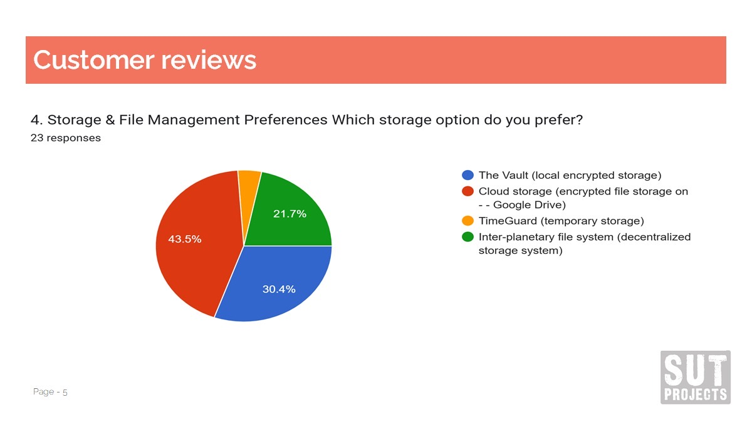

Slide 12
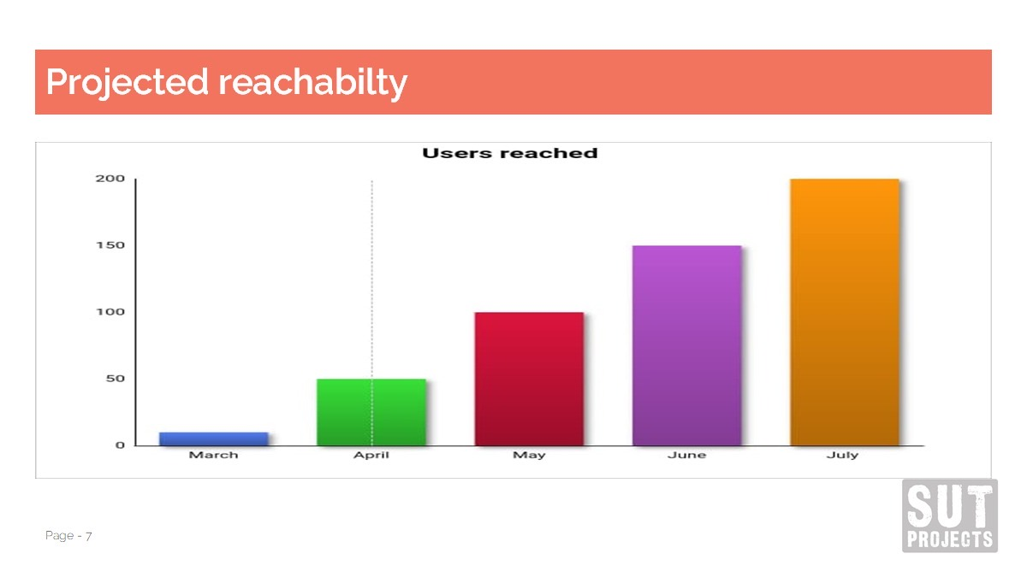

Slide 13
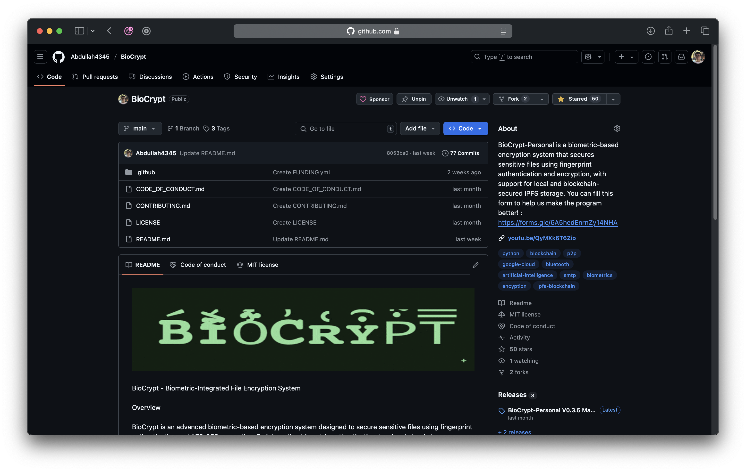
Sponsor Enabled
Survey
Tech-Demo
MIT license
50 STARS⭐️
BioCrypt-Personal Beta

Slide 14
Project Key Features
Key Features • Biometric Authentication: Files are encrypted and decrypted using a key derived from the user’s fingerprint. • AES-256 Encryption: Industry-standard encryption ensures the highest level of security for all files. • The Vault: Secure local encrypted storage with OTP-protected access. • The Cloud: Encrypted file storage using Google Drive with OTP authentication for retrieval and deletion. • SafeMail: Secure file transfer via email with pre-encryption and attached decryption code to prevent man-in-the-middle attacks. • AI File Summarization: Optional smart preview for encrypted files without full decryption. • TimeGuard: Time-locked storage with automatic deletion after a set time or failed access attempts. • SecureFileBeam: Encrypted file transfer over Bluetooth for offline secure sharing. • Interactive Help Bot: Provides real-time assistance within the application. • Customizable Themes: Includes a high-contrast mode for improved accessibility. • IPFS & Blockchain Integration

Slide 15
System Overview Diagram

Slide 16
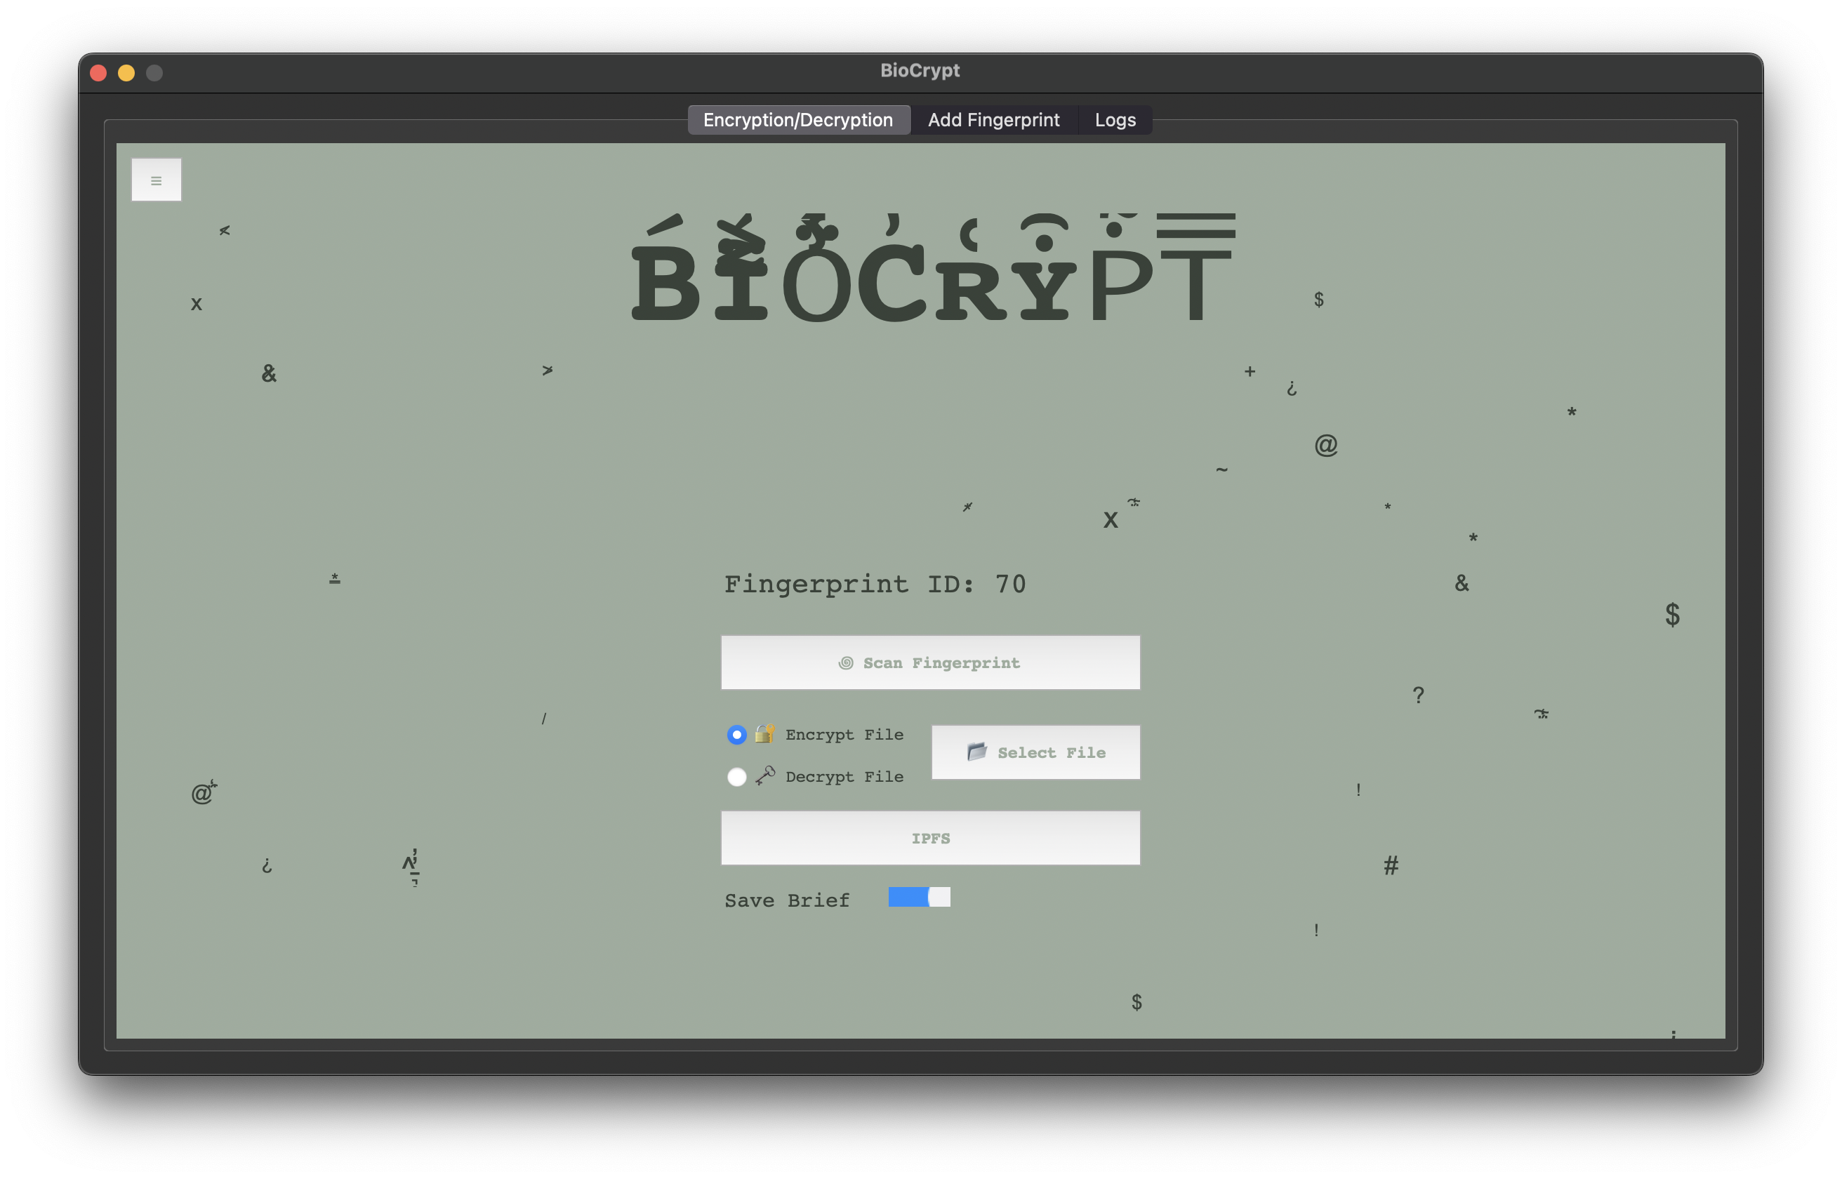
System Overview
Programs Menu
Logs
New Fingerprint
Fingerprint ID
Main Tab
Scan Fingerprint
Operation
Select File
Program Shortcut
Summary Toggel

Slide 17
System Block Diagram

Slide 18
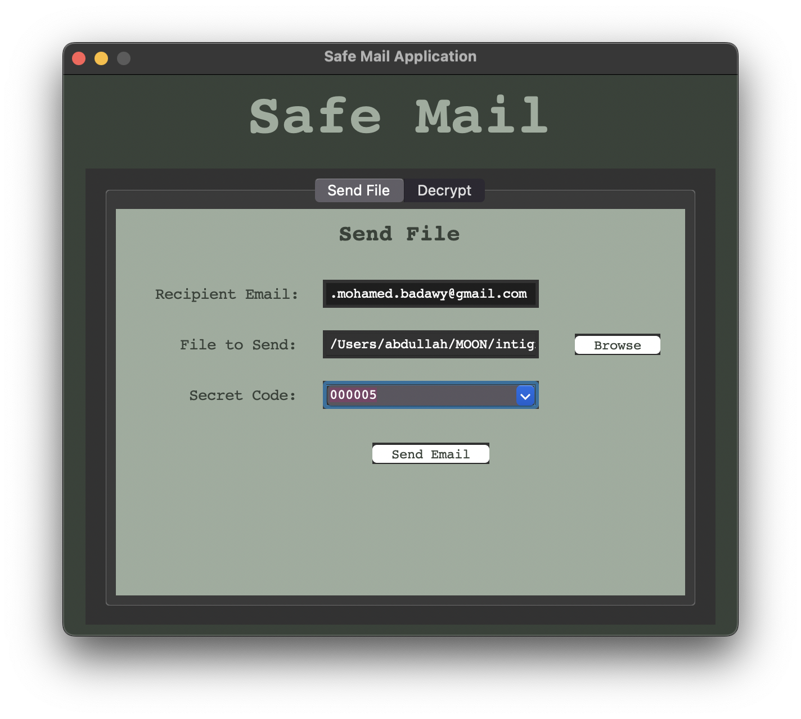
System Overview & Block Diagram
Secret Code
Recipient Email
File
Program Generate 6 Digit code and send it with the encrypted file
Program use 6 Digit code and secret code to form a AES key and encrypt the file

Slide 19
IPFS & Blockchain storage
ChainSpace: This program uses IPFS (InterPlanetary File System) along with the Ethereum Blockchain to deliver one of
the most secure ways to store an encrypted file, the way IPFS works is that it divides the file to many smaller pieces
(256kb) and spread them across decentralized servers around the world, then the program insert the CID (content
Identification) to the Ethereum Blockchain to ensure integrity, the same CID which will be used to retrieve the files from
all the servers and create the file back.

Slide 20
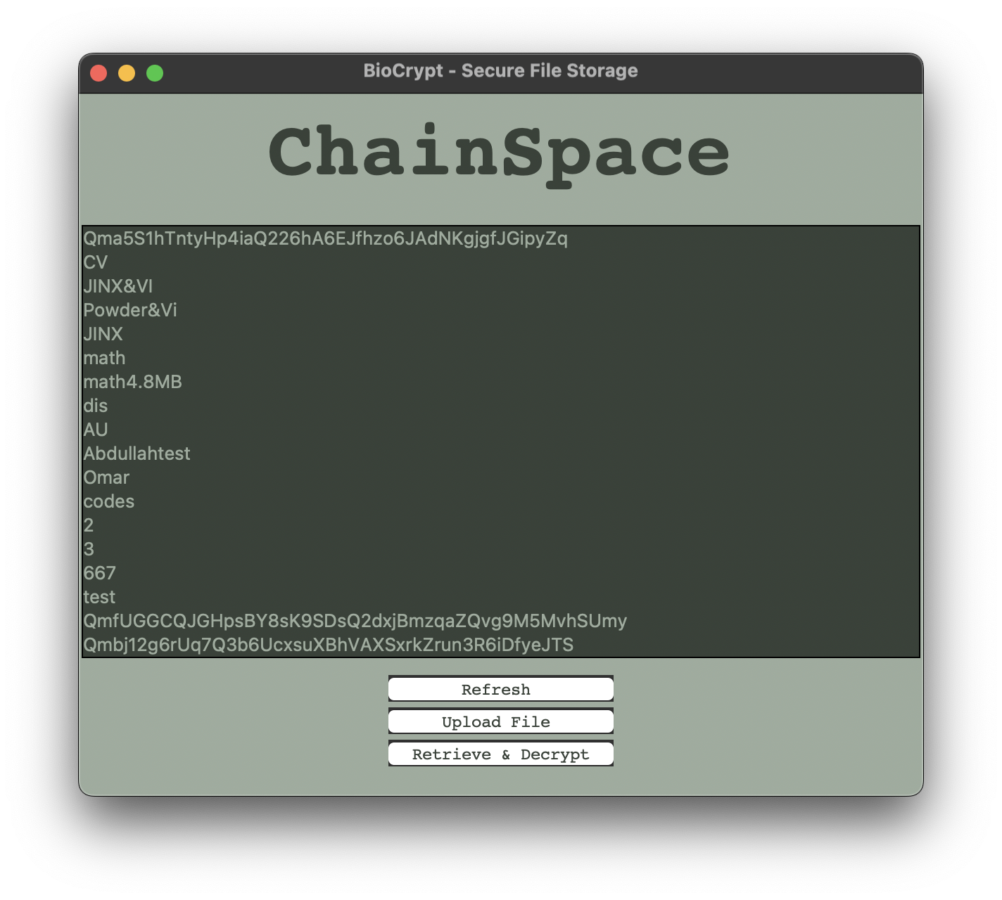

System Overview & Block Diagram
Upload File Using IPFS
Decentrlized Servers around the world
IPFS fragments the Upload to smaller files
Obtain CID
Includes metadata along with a cryptographic hash of the content.
Store CID on Etherium Blockchain
Ensure integrity

Slide 21
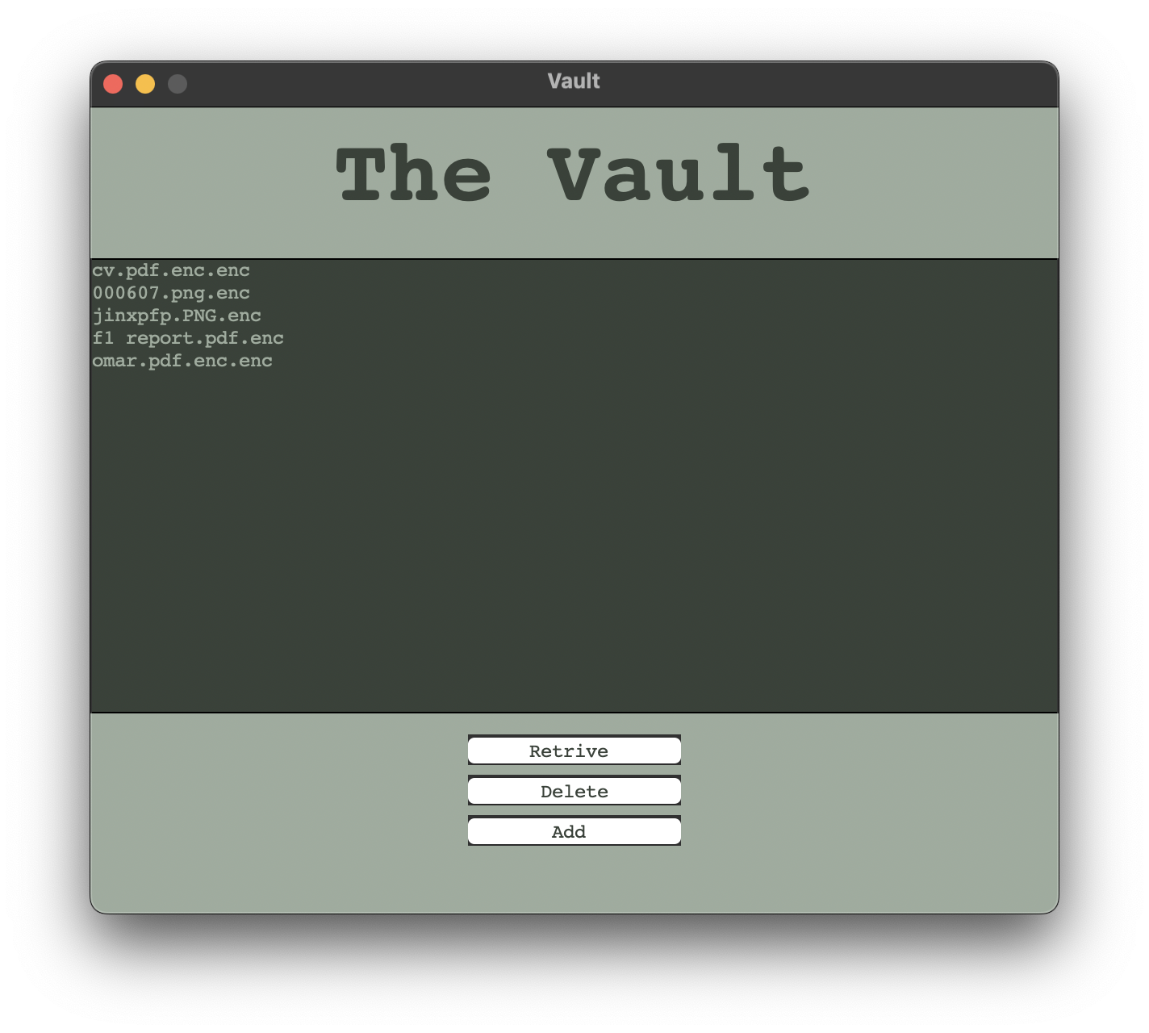
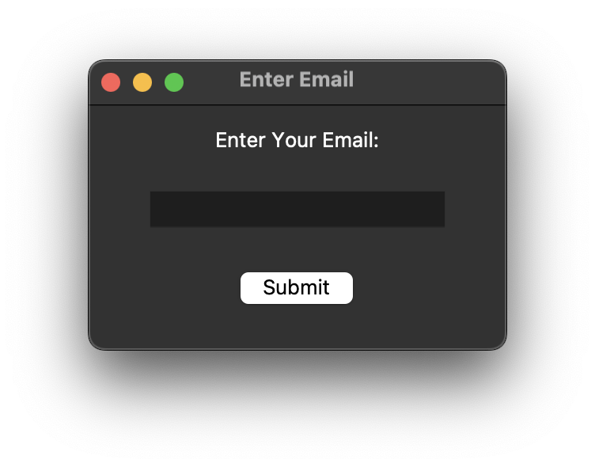
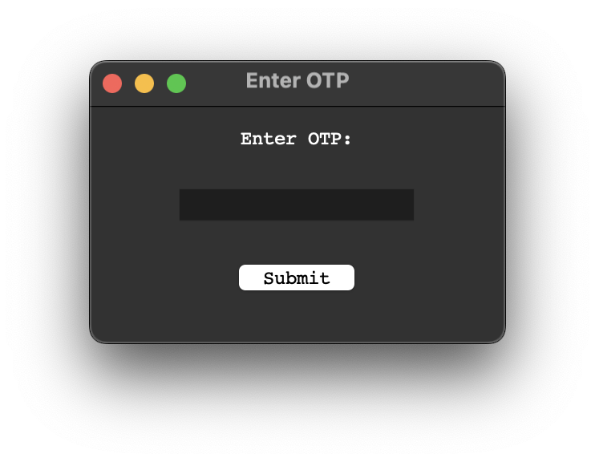
System Overview & Block Diagram
Add File
Retrive File
Enter OTP
Save File
File Encrypted and stored

Slide 22
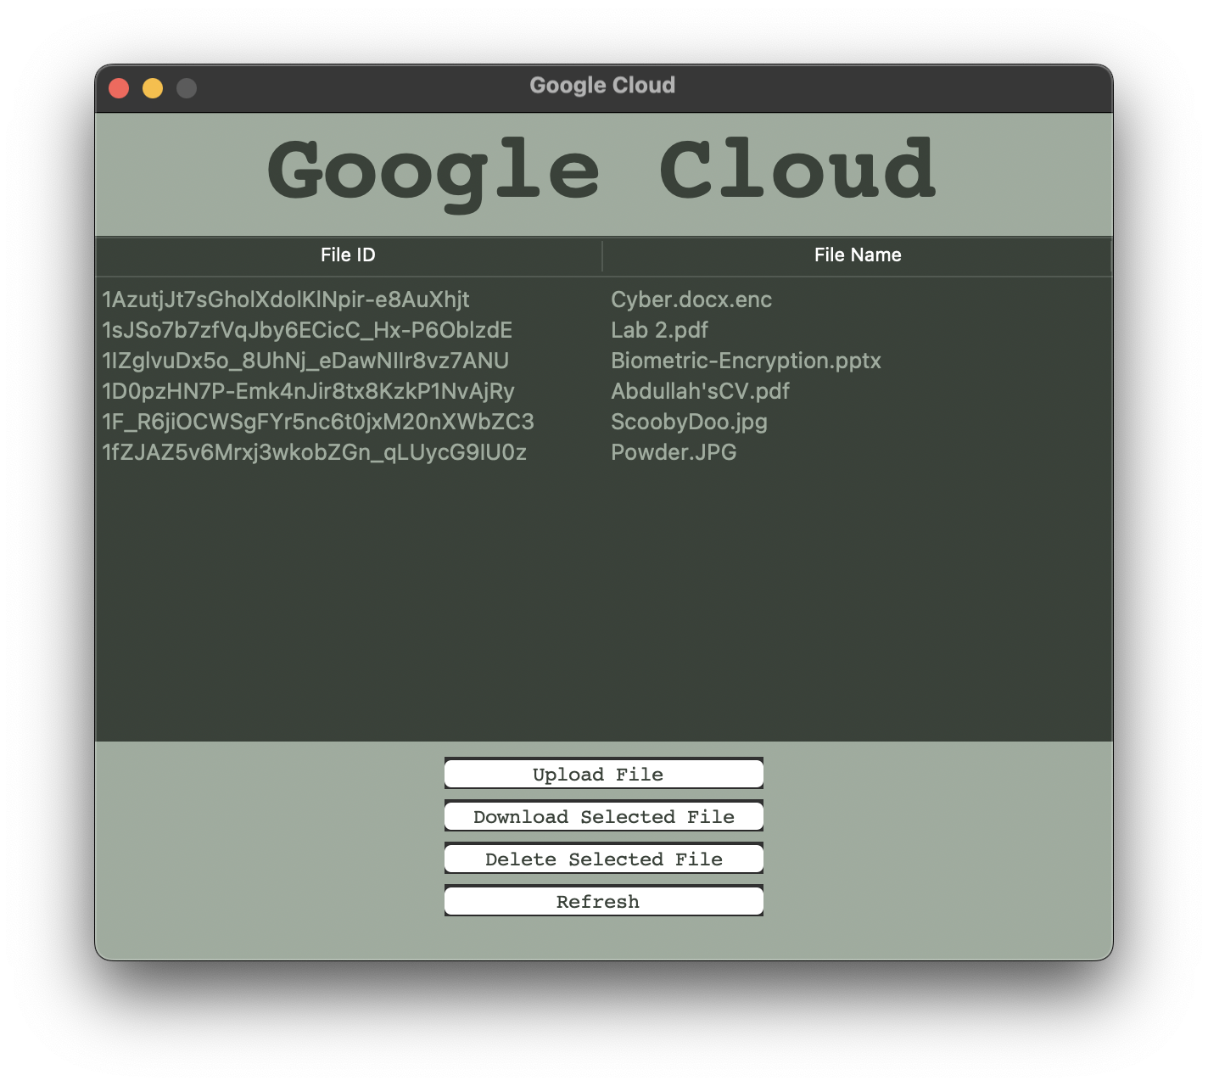
System Overview & Block Diagram
Add File
Retrive File
Enter OTP
Save File
File Encrypted and stored

Slide 23
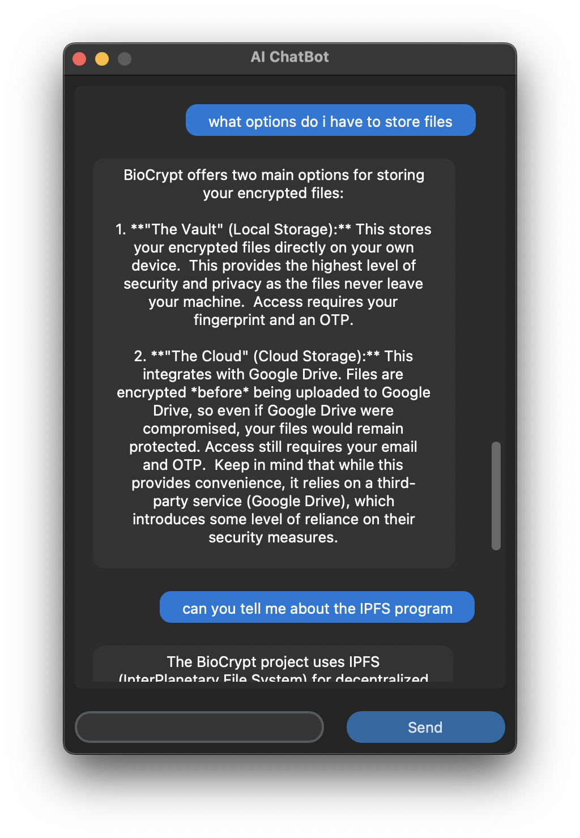
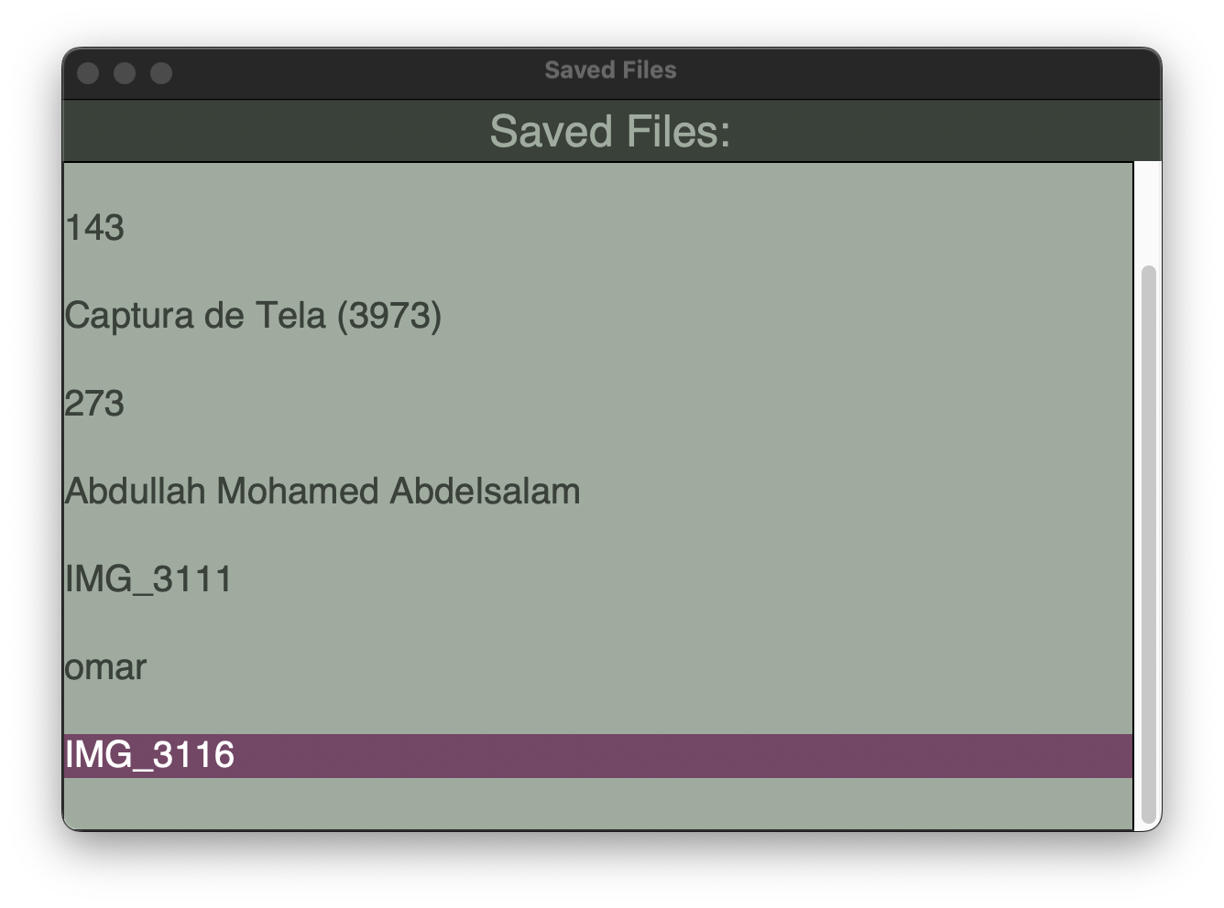
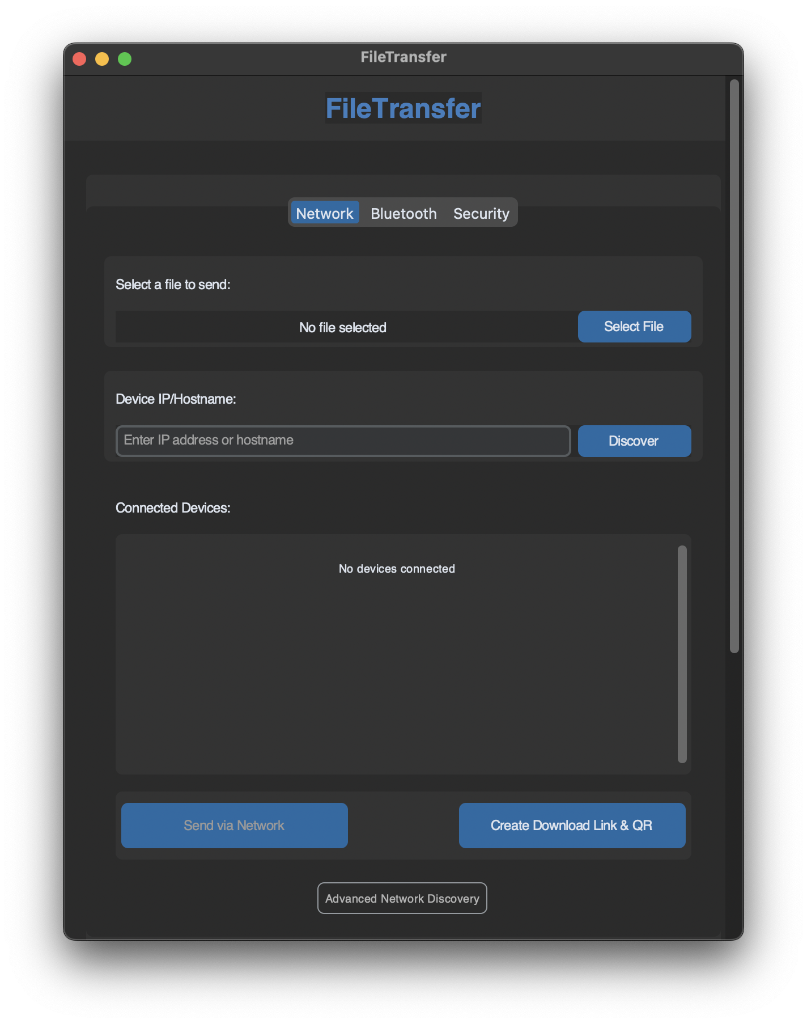
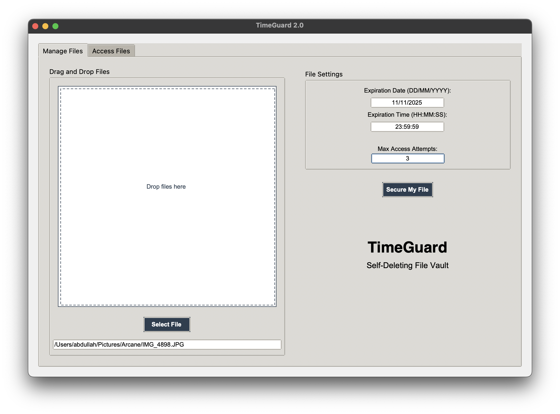
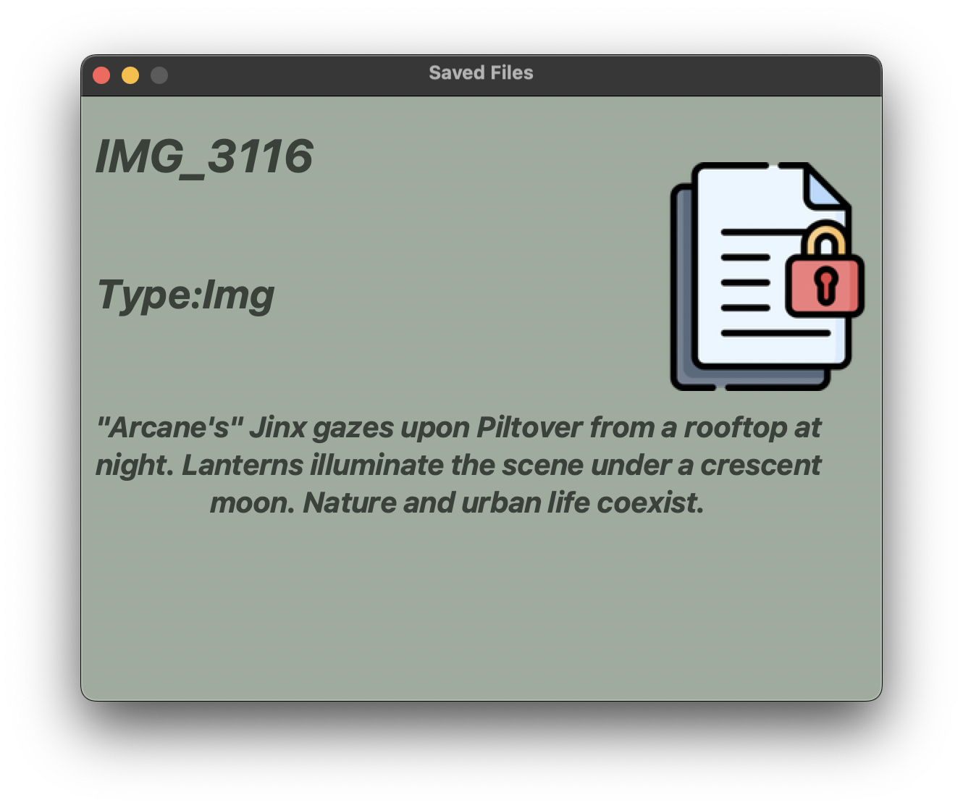
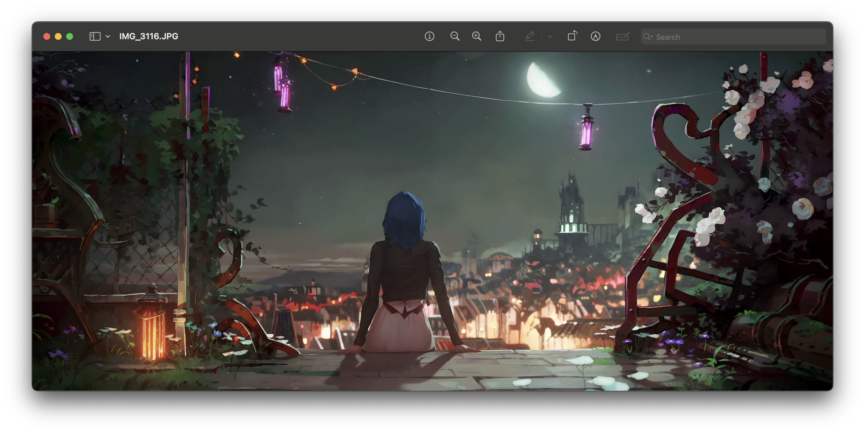
Future Upcoming Programs
AI ChatBot
AI File Summary & Brief
BlueTooth/IP File sender
TimeGuard

Slide 24
Prototype

Slide 25
Any Questions?

